Slide 1
Computer Vision Project Prediction of Covid-19 infections with x-ray images
David Budgenhagen, Leonidas Devetzidis, Alexandru Barsan
Notes:
group;me,in the light of currentevents p

Slide 2
Agenda
Motivation
Why use Deep Learning for Medical Image Analysis?
The project
Dataset
Regularization
Architecture
Evaluation

Slide 3
1. Motivation
- Idea: Medical Image Analysis with Deep Learning
• Help doctors to analyze, model and make sense of complex clinical data
• Aim: Assign the patient to one of a small set of classes (Amato et al. 2013)
• Not new: Medical Image Analysis exists since the 60s (edge and line detector filters)
(Litjens et al. 2017)
- Today: sources from various medical procedures, such as CT, MRI, PET, and X-ray
- Typical applications:
• Detections of structures (organs, body parts) (Lo et al., 1995)
• Segmentation (cardiac and brain analyses, U-Net) (Ronneberger et al. 2015)
• Image classification (disease is present or not with x-ray images) (Antony et al., 2016)

Slide 4
2. Why use Deep Learning for Medical Image Analysis?
Papers show that deep learning approaches exceed the accuracy of trained doctors:
• Skin cancer detection, dermatologist with 66% accuracy versus CNN with 72% accuracy... (Esteva et al., 2017)
• Once the neural networks are trained, debugged and fine tuned, the classification of images is a fast and easy to implement process.
• During the COVID-19 outbreak real-time polymerase chain reaction was the standard method.
• Problem: For ten thousands of people such an analysis cannot be carried out in a short time. Especially in countries without a good laboratory infrastructure (Zhang et al., 2020).
• Chest X-ray is the most commonly used technique for diagnosing patients with thorax abnormalities, because it offers a fast and cheap imaging with low radiation (Self et al., 2013).

Slide 5
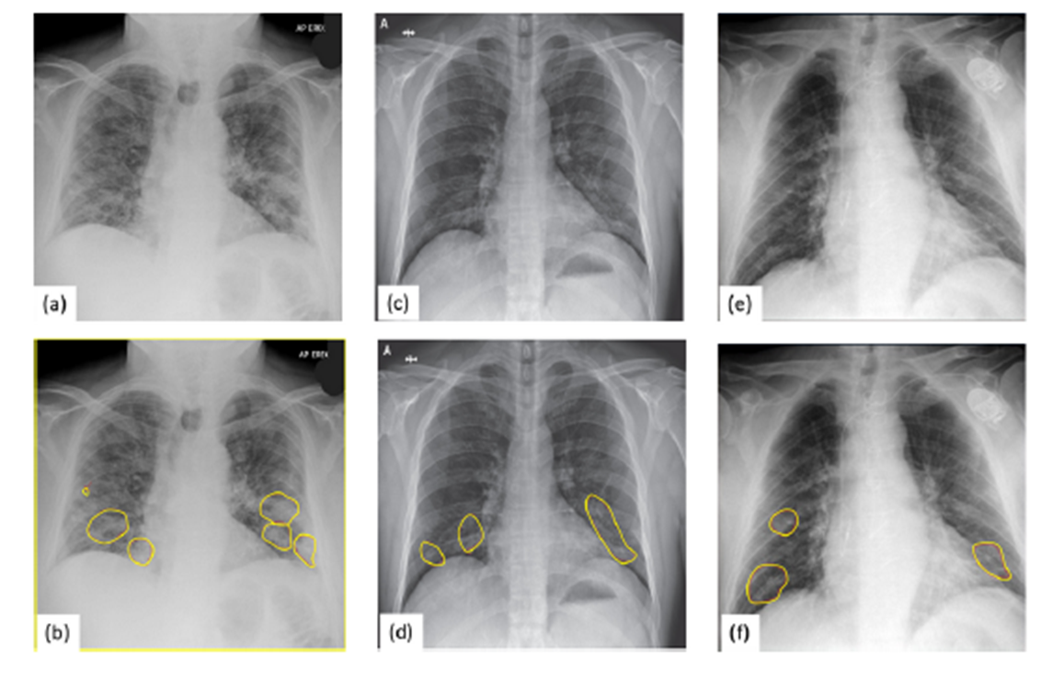
3. The Project
- Detect COVID-19 patients by classifying radiographic lung images
• Clustering of viral pneumonia can often suggest a potential outbreak of COVID-19 infection
• Very challenging for doctors to interpret correctly
(Joarder & Crundwell, 2009) -> distinguish between
different types of pneumonia
- There are approaches that have shown that
the recognition of COVID-19 by X-ray images is
possible and useful
(Minaee et al., 2020 ;Zhang et al., 2020 )
COVID-19 images and the corresponding marked areas by radiologist (Minaee et al., 2020)
https://www.ncbi.nlm.nih.gov/pmc/articles/PMC7372265/

Slide 6
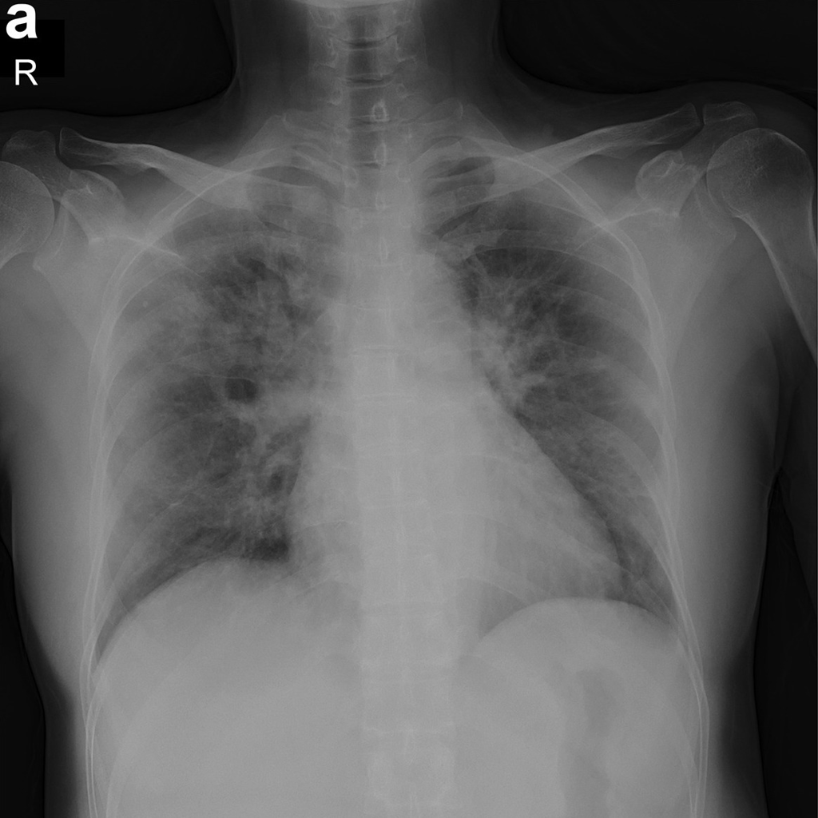
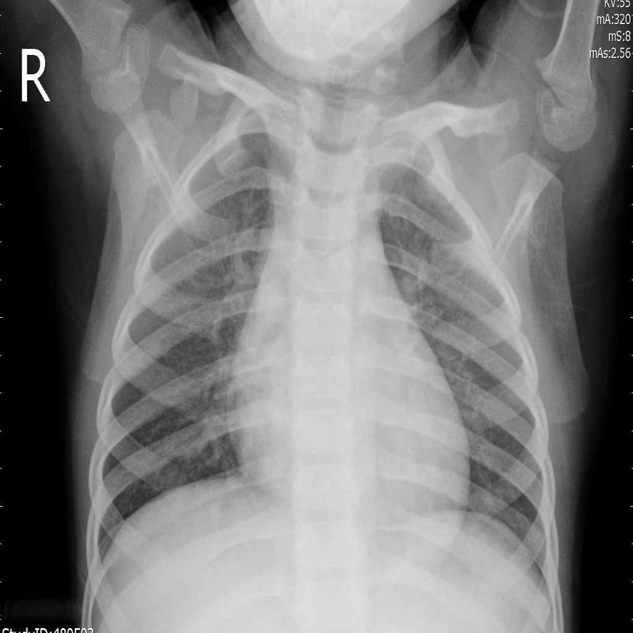
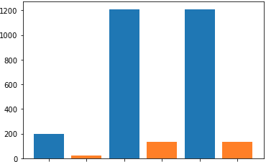
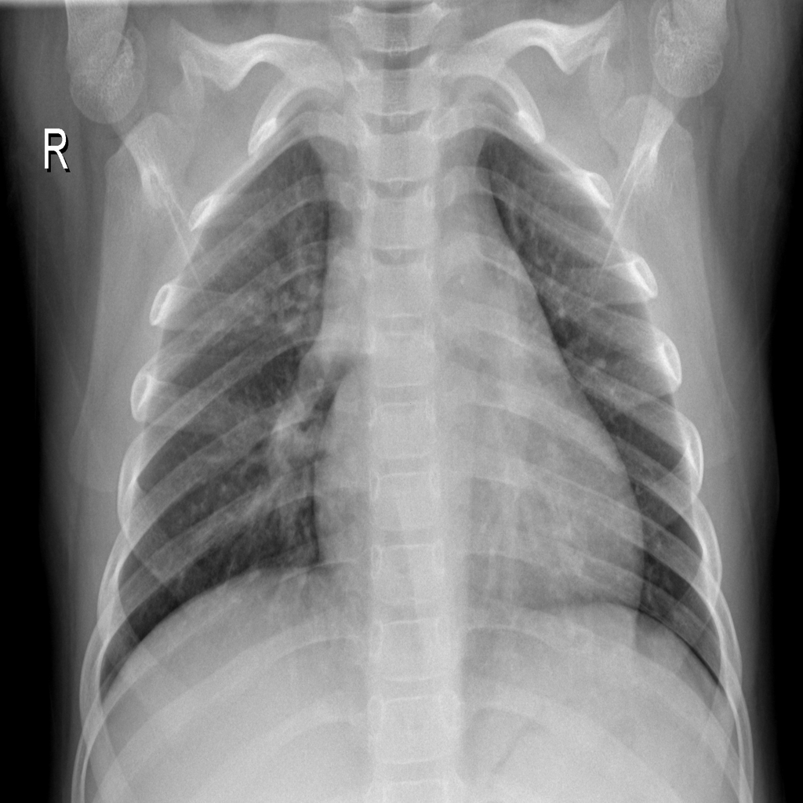
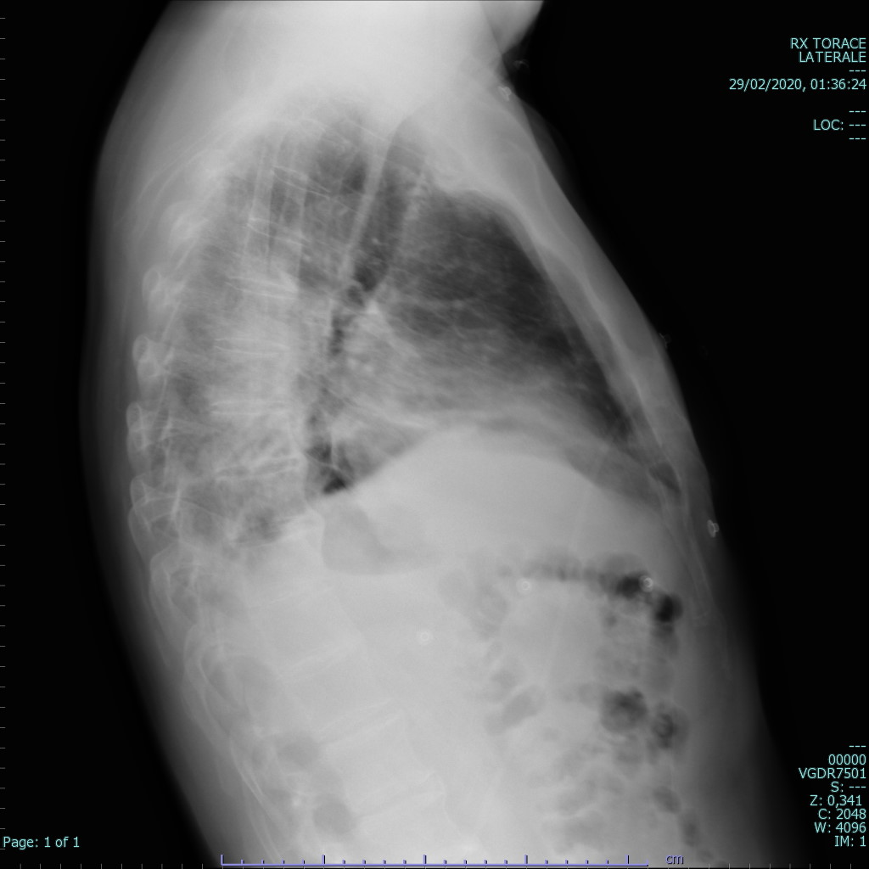
4. Dataset
Initial Dataset:
• https://www.kaggle.com/tawsifurrahman/covid19-radiography-database (version 1)
• 219 COVID-19 positive images, 1341 normal images and 1345 viral pneumonia images
• Cons: Low amount of covid images. Highly unbalanced dataset.
Training Data 90%
COVID
VIRAL PNEUMONIA
Test Data 10%
COVID
NORMAL
VIRAL PNEUMONIA
NORMAL
SIDE IMAGES
https://www.kaggle.com/tawsifurrahman/covid19-radiography-database

Slide 7
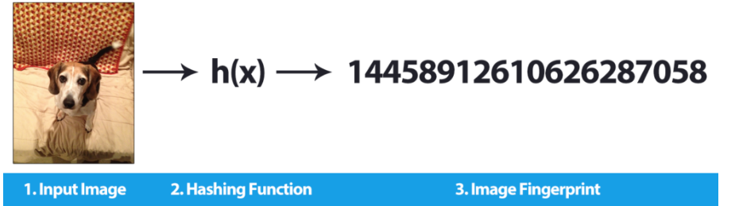
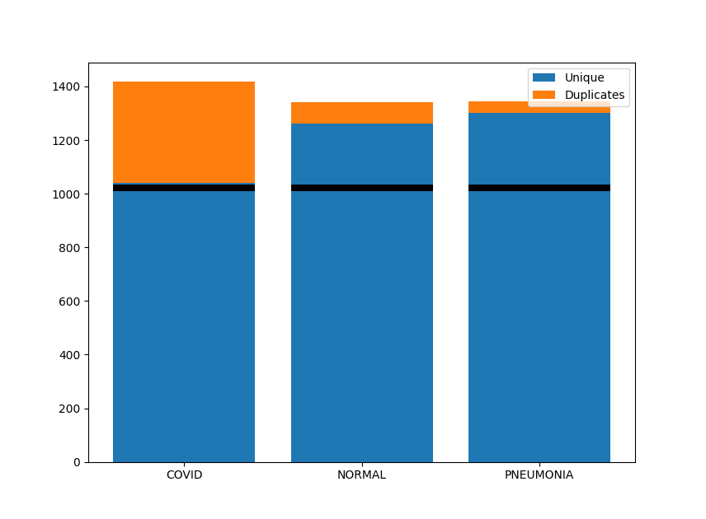
4. Dataset
Current Dataset:
• https://www.kaggle.com/tawsifurrahman/covid19-radiography-database (version 3)
• 1200 COVID-19 positive images, 1341 normal images and 1345 viral pneumonia images
• removed duplicates: image-hash comparison
• removed side photos
• balanced the dataset : uniform distribution -> 1028 images from each category
https://www.pyimagesearch.com/2017/11/27/image-hashing-opencv-python/
SIDE IMAGES
https://www.kaggle.com/tawsifurrahman/covid19-radiography-database

Slide 8
5.Regularization

Slide 9
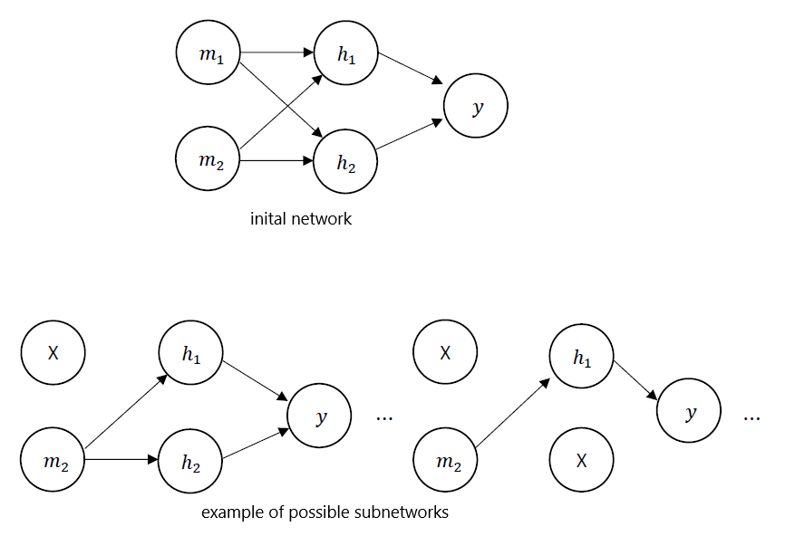
5. Regularization: Dropout

Slide 10
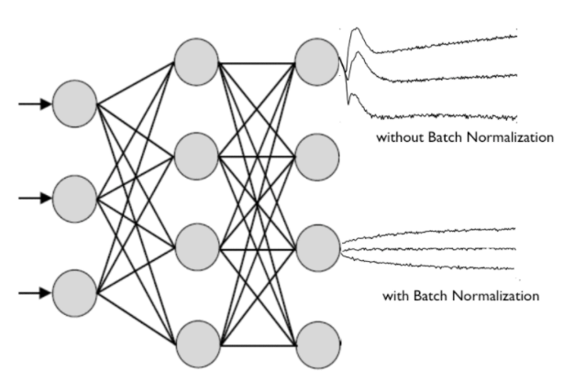
5. Regularization: Batch Normalization
calculatedcontent.com

Slide 11
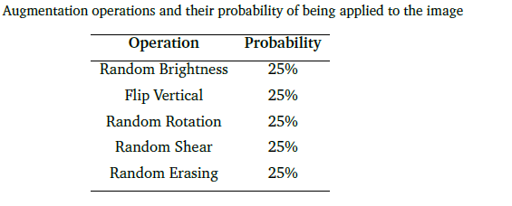
5. Regularization: Data Augmentation

Slide 12
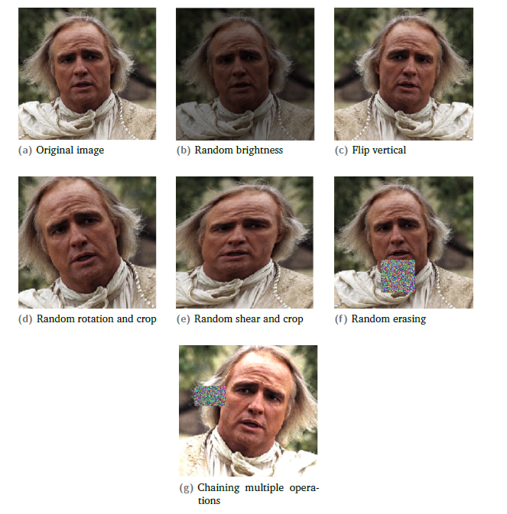
5. Regularization: Data Augmentation

Slide 13
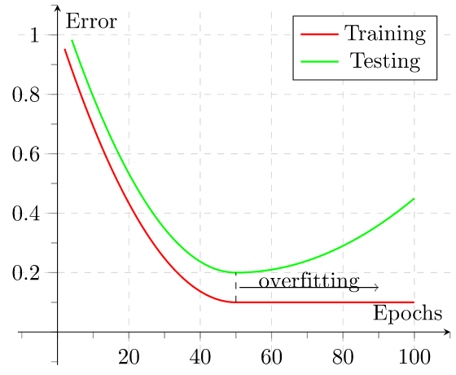
5. Regularization: Early stopping
siegel.work

Slide 14
6.Architecture

Slide 15
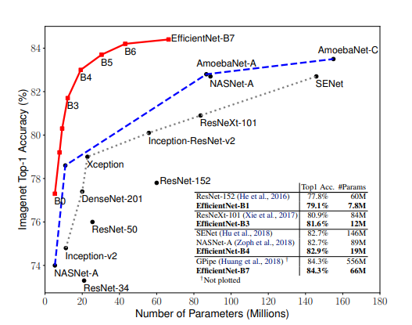
6. Architecture: EfficientNet
• Presented by Tan and Le in 2019
• Their study comprises compound scaling method that efficiently scales network to achieve better performance
• Model resulted in state-of-the-art 84.4% top-1 accuracy on ImageNet while being 8.4x smaller and
6x times faster on inference than the best existing convolutional model.
https://arxiv.org/pdf/1905.11946.pdf

Slide 16
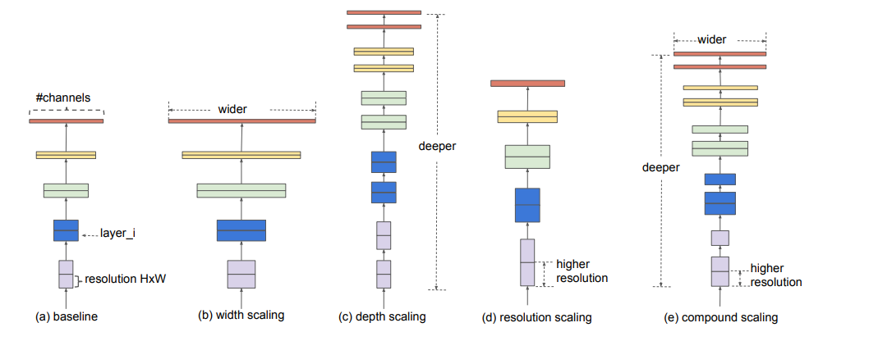
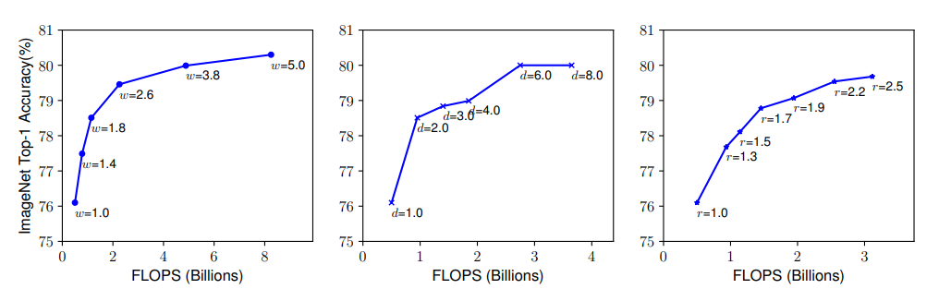
6. Architecture: EfficientNet
• Conventional methods arbitrary scale either the width, depth or the resolution
• In contrast, EfficientNets scale all the factors uniformly with a set of fixed scaling coefficients
• Authors observed: scaling up any dimension of the network separately
improved accuracy, but the accuracy-gain diminished as the model increased
https://arxiv.org/pdf/1905.11946.pdf

Slide 17
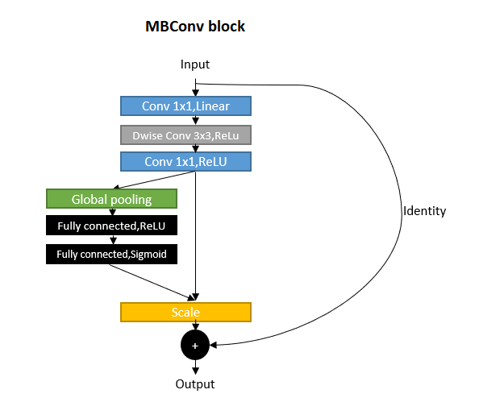
6. Architecture: EfficientNet

Slide 18
7.Evaluation

Slide 19
7.Evaluation: Model Summary
• For the experiments we trained several models for 100 epochs and measured their performance.
• All models trained with Adam optimizer and inital learning rate of 0.001.
• Varying batch-sizes & image resolutions
Model | Input resolution | Batch size | Regularization
Naive CNN with 5 layers | 300x300 | 64 | ✘
EfficientNetB7 | 600x600 | 4 | ✓
EfficientNetB7 | 360x360 | 16 | ✓
EfficientNetB7 | 475x475 | 8 | ✓

Slide 20
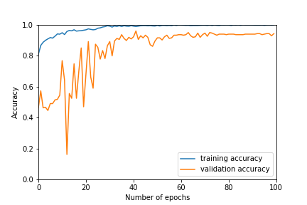
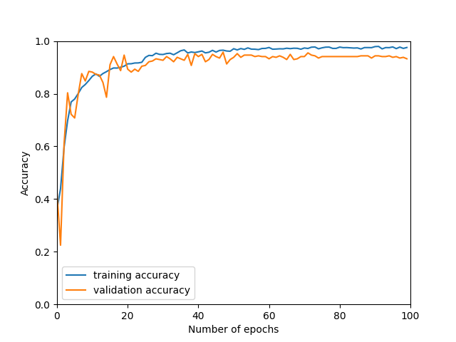
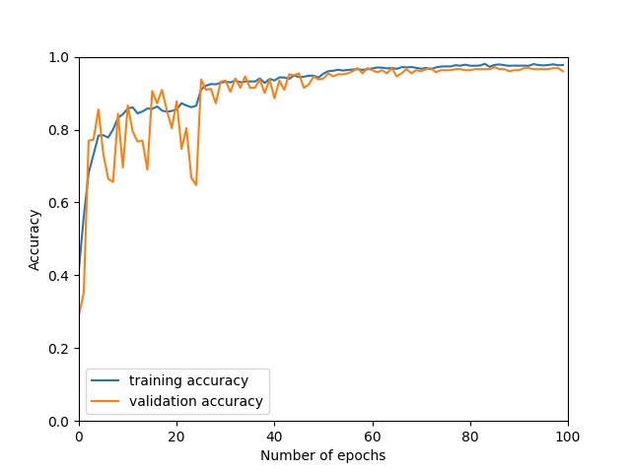
7.Evaluation: Training/Validation Accuracy
Model | Input size | Batch size | Validation Accuracy
Naive CNN with 5 layers (left) | 300x300 | 64 | 91.43% (epoch 42)
EfficientNetB7 (middle) | 600x600 | 4 | 95.79% (epoch 47)
EfficientNetB7 | 360x360 | 16 | 96.88% (epoch 46)
EfficientNetB7 (right) | 475x475 | 8 | 97.16% (epoch 80)

Slide 21
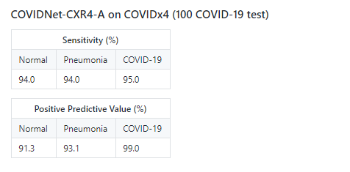
7.Evaluation: Metrics
EfficientNetB7 600x600 Batch size 4 | Precision | Recall | F1-Score | Support
Normal | 0.99 | 0.98 | 0.99 | 103
Corona | 0.86 | 1.00 | 0.92 | 126
Pneumonia | 0.98 | 0.83 | 0.90 | 130
COVIDNet-CXR4-A (100 Test images)
(=Recall)
(=Precision)
EfficientNetB7 360x360 Batch size 16 | Precision | Recall | F1-Score | Support
Normal | 0.99 | 0.98 | 0.99 | 103
Corona | 0.86 | 1.00 | 0.92 | 126
Pneumonia | 0.98 | 0.83 | 0.90 | 130
https://github.com/lindawangg/COVID-Net
EfficientNetB7 475x475 Batch size 8 | Precision | Recall | F1-Score | Support
Normal | 0.99 | 0.96 | 0.98 | 103
Corona | 0.92 | 1.00 | 0.96 | 126
Pneumonia | 0.98 | 0.92 | 0.94 | 130

Slide 22
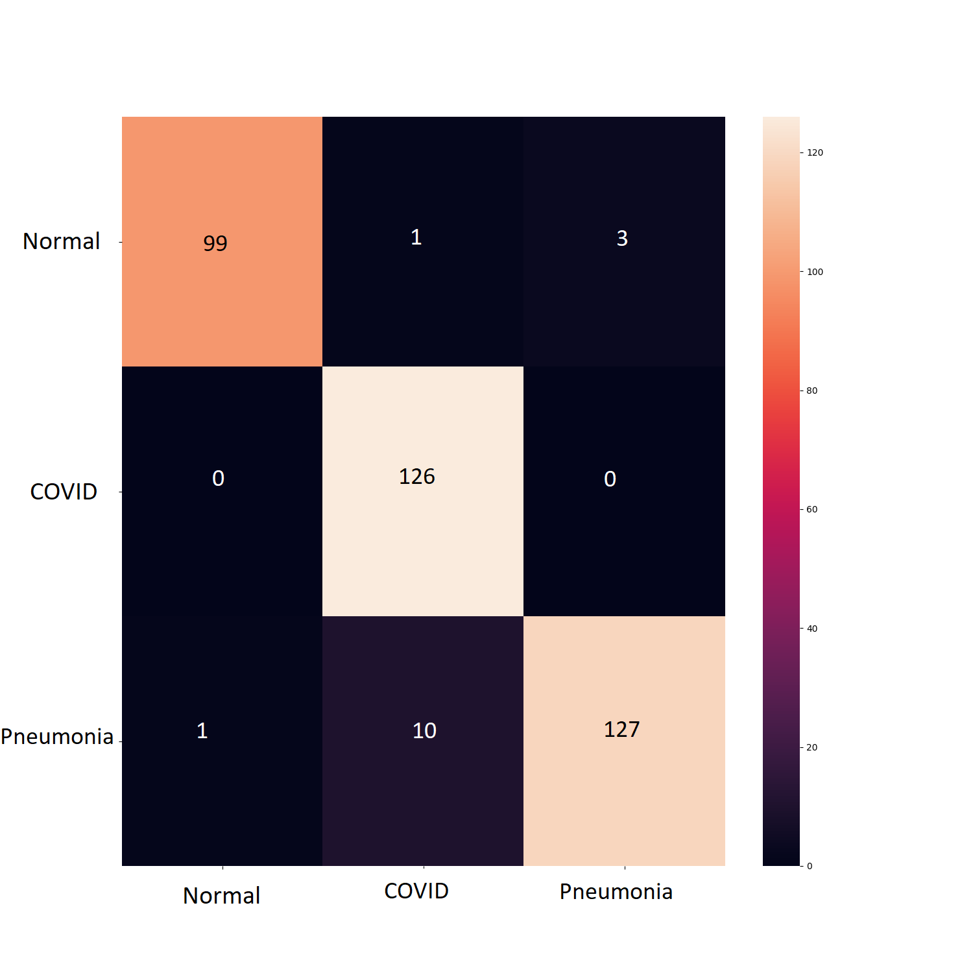
7.Evaluation: Confusion Matrix
EfficientNetB7 Input size 475x475 Batch size 8

Slide 23
Literature I
Amato, F., López, A., Peña-Méndez, E. M., Vaňhara, P., Hampl, A., & Havel, J. (2013). Artificial neural networks in medical diagnosis.
Litjens, G., Kooi, T., Bejnordi, B. E., Setio, A. A. A., Ciompi, F., Ghafoorian, M., ... & Sánchez, C. I. (2017). A survey on deep learning in medical image analysis. Medical image analysis, 42, 60-88.
Ronneberger, O., Fischer, P., Brox, T., 2015. U-net: convolutional networks for biomedical image segmentation. In: Proceedings of the Medical Image Comput- ing and Computer-Assisted Intervention. In: Lecture Notes in Computer Science, 9351, pp. 234–241. doi: 10.1007/978- 3- 319- 24574- 4 _ 28 .
Antony, J., McGuinness, K., O'Connor, N. E., & Moran, K. (2016, December). Quantifying radiographic knee osteoarthritis severity using deep convolutional neural networks. In 2016 23rd International Conference on Pattern Recognition (ICPR) (pp. 1195-1200). IEEE.
Lo, S. C. B., Chan, H. P., Lin, J. S., Li, H., Freedman, M. T., & Mun, S. K. (1995). Artificial convolution neural network for medical image pattern recognition. Neural networks, 8(7-8), 1201-1214.
Esteva, A., Kuprel, B., Novoa, R. A., Ko, J., Swetter, S. M., Blau, H. M., & Thrun, S. (2017). Dermatologist-level classification of skin cancer with deep neural networks. nature, 542(7639), 115-118.
Zhang, J., Xie, Y., Pang, G., Liao, Z., Verjans, J., Li, W., ... & Xia, Y. Viral Pneumonia Screening on Chest X-rays Using Confidence-Aware Anomaly Detection. IEEE transactions on medical imaging.
Self, W. H., Courtney, D. M., McNaughton, C. D., Wunderink, R. G., & Kline, J. A. (2013). High discordance of chest x-ray and computed tomography for detection of pulmonary opacities in ED patients: implications for diagnosing pneumonia. The American journal of emergency medicine, 31(2), 401-405.

Slide 24
Literature II
Joarder, R., & Crundwell, N. (2009). Chest X-ray in clinical practice. Springer Science & Business Media.
Minaee, S., Kafieh, R., Sonka, M., Yazdani, S., & Soufi, G. J. (2020). Deep-covid: Predicting covid-19 from chest x-ray images using deep transfer learning. arXiv preprint arXiv:2004.09363
Zhang, J., Xie, Y., Pang, G., Liao, Z., Verjans, J., Li, W., ... & Xia, Y. Viral Pneumonia Screening on Chest X-rays Using Confidence-Aware Anomaly Detection. IEEE transactions on medical imaging.
Selvaraju, R. R., Cogswell, M., Das, A., Vedantam, R., Parikh, D., & Batra, D. (2017). Grad-cam: Visual explanations from deep networks via gradient-based localization. In Proceedings of the IEEE international conference on computer vision (pp. 618-626).
Wang, L., Lin, Z. Q., & Wong, A. (2020). Covid-net: A tailored deep convolutional neural network design for detection of covid-19 cases from chest x-ray images. Scientific Reports, 10(1), 1-12.

